Slide 1
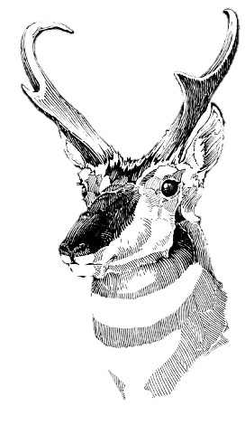
104th annual meeting
American Society
of Mammalogists awards ceremony

Slide 2
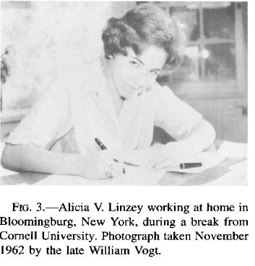
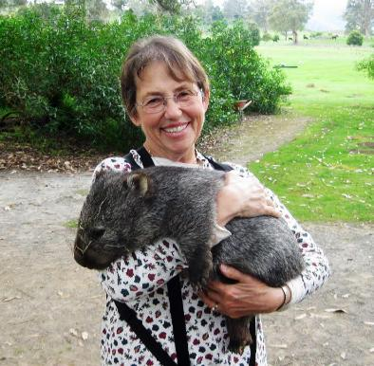
President’s special award for service to the ASM
Alicia in Tasmania

Slide 3
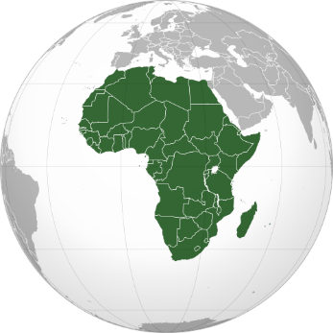
Alicia V. Linzey award
Top applicant for the African Research Fellowship
Notes:
Newly created by BOD.

Slide 4

2025 Carol & Jim Patton Awards
Vinícius Araújo Costa, Universidade Federal da Paraíba - Brazil
Gabriele Zenato Lazzari, Pontifícia Universidade Católica do Rio Grande do Sul – Brazil
Sofía B. Iturrieta Jeno, Universidad de Valparaíso – Chile
Jennifer González Buve, Universidad de la República - Uruguay
2025 ASM International Travel Awards
Démétrius Ella Delphine Harisoamalala, graduate student, Madagascar
Aristide Junior Sock Bell, graduate student, Cameroon
Evance Ouya, post-graduate, Kenya
Catalina Tomé,
Chair
International Relations Committee

Slide 5
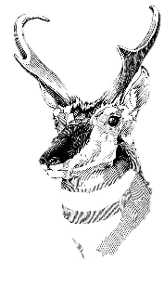
2025
African Research Fellowships
Jesse Alston
Link Olson, co-Chairs
(Marissa Dyck, presenting)
Yurica Jeje – Mozambique, MSc – community ecology of bats
Benford Kayuni – Malawi, MSc – community ecology of bats
Adams Kipchumba – Kenya, PhD – conservation of giraffes
Chanel Lewis – South Africa, PhD – gut physiology of ruminants
Lesedi Mokanyane – South Africa, MSc – behavioral ecology of sengis
Christine Mwende – Kenya, MSc – conservation of elephants
Chanel Rampartab – South Africa, PhD – thermal ecology of small mammals
Kyle Smith – South Africa, PhD – ecology of African striped weasels
Notes:
Presented by … Marissa Dyck

Slide 6

2025 Latin American Student
Field Research Awards
Andrea Bernal-Rivera (Colombia). University of Washington
Silvia Ruby Díaz Peña (Perú). Universidad Nacional Mayor de San Marcos, Perú
Valentín Zarate (Argentina). Universidad Nacional de Córdoba, Argentina
Antonella Cevoli (Argentina). Universidad de Buenos Aires, Argentina
Raquel Alvarado Larios (El Salvador). Universidad Nacional de Cuyo, Argentina
Sergio Hernández (Cuba). Universidad Autónoma del Estado de Morelos, México
*All Ph.D. students
Sergio A. Solari,
Chair
Latin American Fellowship Committee

Slide 7
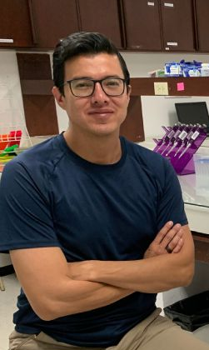
2025 Oliver P. Pearson Award
Daniel Chávez (Ecuador)
Associate Professor and researcher in the Pontificia Universidad Católica del Ecuador (PUCE)
Notes:
Nicté Ordóñez, Chair
Latin American Fellowship Committee

Slide 8
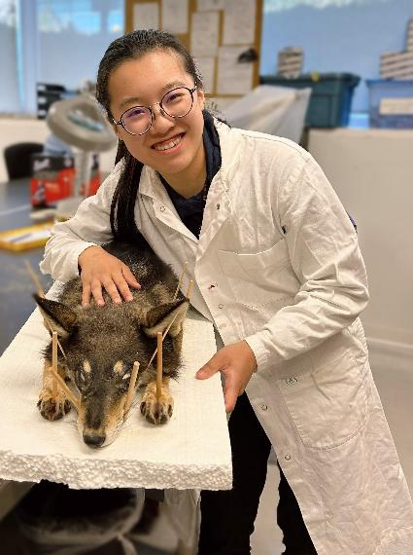
2025 James L. Patton Award
Yizi (Iris) Li
PhD student, University of British Columbia
Notes:
(THEY go by name Iris)

Slide 9

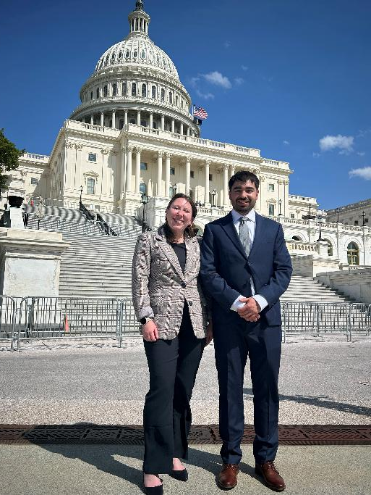
Student Science Policy Awards
2025 recipients:
Nicole Gorman (Virginia Tech)
John Paul Williams Soriano (University of Michigan)

Slide 10
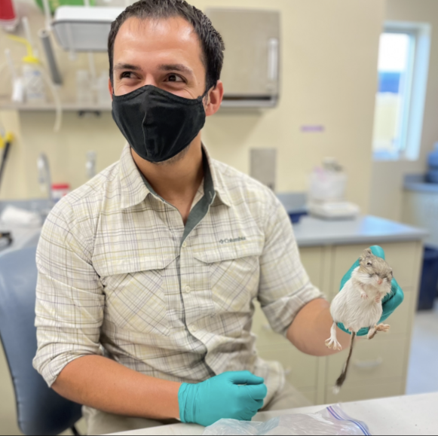
2025 Guy N. Cameron Award
Joshua Cortez

Slide 11
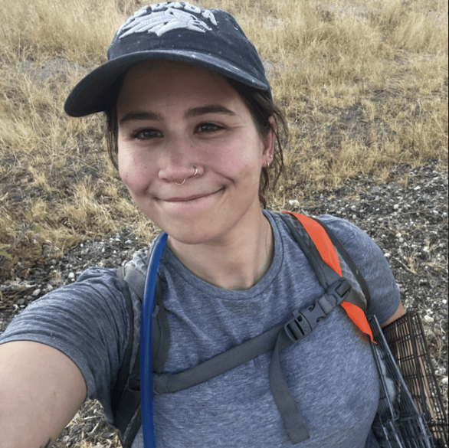
2025 Guy N. Cameron Award
Anita Pilar Montero

Slide 12
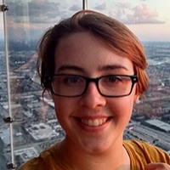
2025 Donald W. and Glennis A. Kaufman Award
Emilyn J. Gilmore,
University of Oklahoma

Slide 13
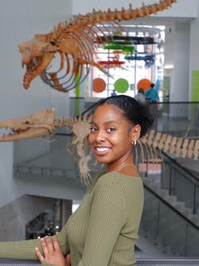
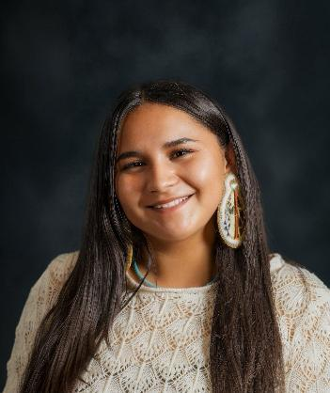
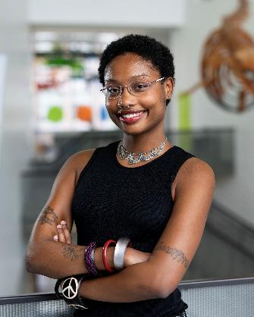
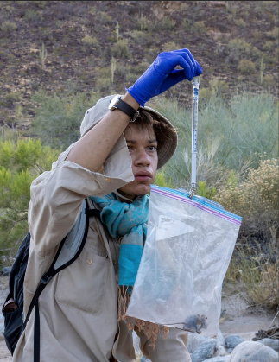
2025 Black & Indigenous Scholarship Awards
Cheyenne Graham
Lizzy Osterhoudt
Mars Woodward
Alexander Fenlon

Slide 14
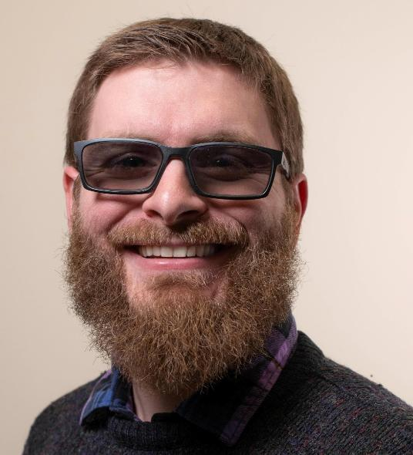
2025 J. Mary Taylor Award
Dakota Rowsey

Slide 15

2025 Rising Undergraduates in Mammalogy travel support
-
Courtney Morgan, North Carolina State University
Patricia Sotleo Chavira, University of New Mexico
Erick Jesús García Trujano, Universidad Nacional Autónoma de México
Kane Anaya, University of New Mexico
Andrea Aguirre Salazar, North Carolina State University
Laurie Dizney and
Tokay Alberts,
co-Chairs
IDEA committee
(presented by Liz Flaherty)
Notes:
IDEA committee

Slide 16
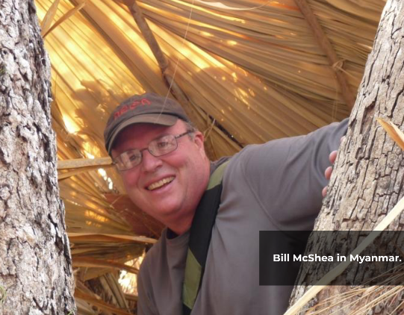
2025 Aldo Leopold Award
Bill McShea

Slide 17
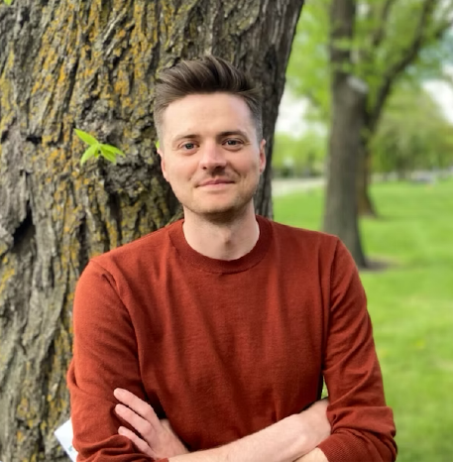
2025 Murie Family Conservation Award
Michael Peers

Slide 18
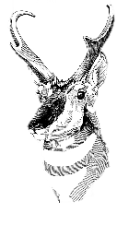
2025 Grants-in-Aid of Research
Tokay Alberts San Francisco State University
Hannah Ashe University of Wisconsin-Madison
Lexi Baca University of New Mexico
Olivia Chapman UNC-Greensboro
Kristin Dyer University of Oklahoma
Serena Frazee Oregon State
Andrew Gaier City College of New York
Holly Gamblin University of Manitoba
Carolina Ganci UMass-Dartmouth
Christopher Hickling University of Rhode Island
Austin Jameson Old Dominion University
Brian Kirz University of Rochester
Helen Krueger South Dakota State University
Zoe Leone Chicago State University
Renee Lile University of Wyoming
Kyle Martin University of Idaho
Fiona McKibben University of Idaho
Phoebe Morris Oregon State University
Natalie Morris University of Arizona
Ruby Mustill Texas A&M
Esteban Restrepo-Cortés University of New Mexico
Damien Rivera Arizona State University
Nicholas Ryan University of New Mexico
Mariah Schlis-Elias University of Michigan
Alyssa Semerdjian Oregon State University
Sarah Senese Denver University
Samuel Speck Kansas State
Katharine Walls Vanderbilt University
Imogene Welles University of Stony Brook
Joshua Willems University of New Hampshire

Slide 19
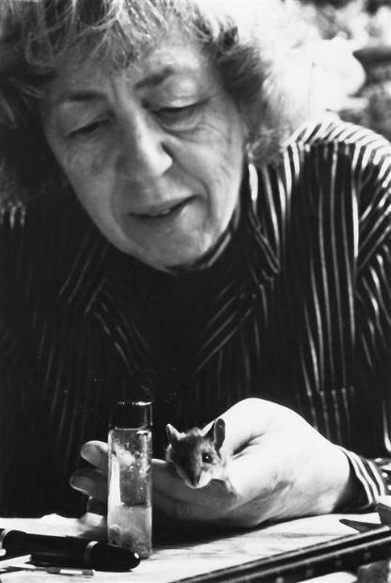
Elizabeth Horner Award
Andrew Gaier,
City College of New York
Sampling mammalian communities of the Sheeprock Mountain sky-island

Slide 20
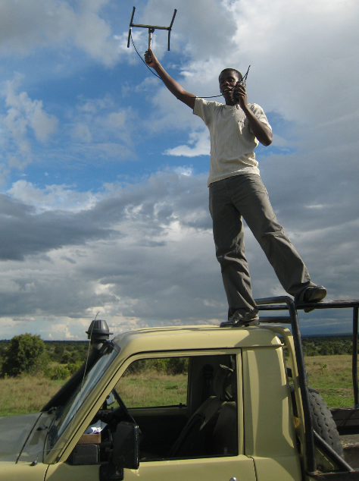
Albert R. and Alma Shadle Fellowship
Douglas Kamaru
University of Wyoming
Iowa State University

Slide 21
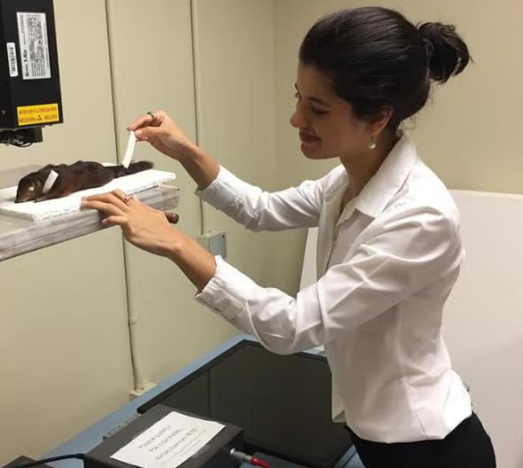
Maya Juman
University of Cambridge
ASM Fellowship

Slide 22
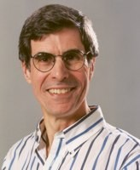
2025 Hartley T. Jackson Award
Guy Cameron
Hartley Jackson and Vernon Bailey, 1935

Slide 23
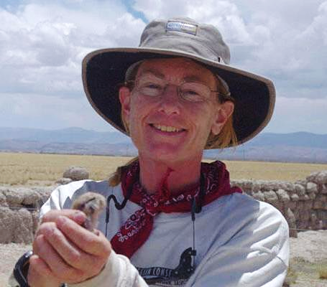
2025 Joseph Grinnell Award
Eileen Lacey

Slide 24
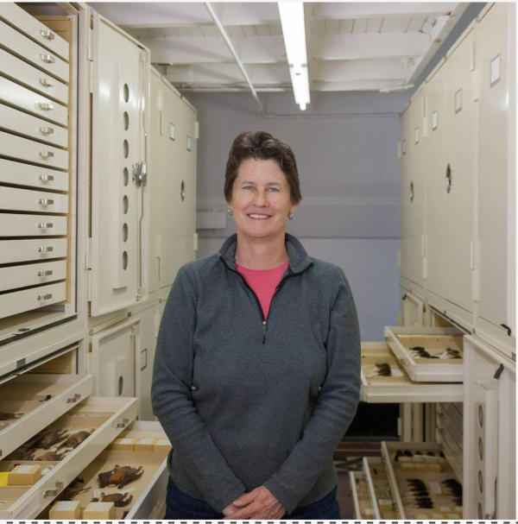
2025 C.H. Merriam Award
Nancy Simmons

